Slide 1


K.RAMAKRISHNAN COLLEGE OF TECHNOLOGY (AUTONOMOUS), TRICHY AUTOMATED QUESTION GENERATOR AND SUMMARIZER USING MACHINE LEARNING
PRESENTED BY,
KABILESHWARAN K (811721243022)
MELWIN AB (811721243027)
MOHAMED FAIZUL S (811721243030)
RAVIDHARSHEN MK (811721243043)
GUIDED BY,
Mrs.P.JASMINE JOSE M.E.,
ASSISTANT PROFESSOR/ AI

Slide 2
PRESENTATION OVERVIEW
Objective
Introduction
Existing System
Proposed System
Literature Survey
Architectures
System Requirements
Modules
Application
Advantage
Conclusion
Reference

Slide 3
OBJECTIVE
The objective of the automated question generator and summarizer using BERT is to streamline the process of content analysis and comprehension.
It aims to automatically generate contextually relevant questions from input text, facilitating better understanding and assessment.
Additionally, it provides concise and accurate summaries of lengthy documents, preserving key ideas. This system enhances efficiency in education, research, and content review by automating time-consuming tasks.

Slide 4
INTRODUCTION
Uses BERT to extract key information from text and generate relevant questions, useful for education, quizzes, and content understanding.
Leverages BERT’s contextual understanding to condense large texts into concise, accurate summaries while preserving essential information.
Automates time-consuming tasks like content review, question preparation, and summarization, enhancing productivity in education and research

Slide 5
EXISTING SYSTEM
Earlier systems relied on rigid rule-based approaches, limiting flexibility and depth in understanding text.
Many models struggled to understand full context, often generating inaccurate or irrelevant output.
Traditional systems underperformed with large texts, producing ineffective summaries.
Extractive summarization models often failed to capture deeper meaning, resulting in redundant or incoherent summaries.
Existing systems lacked adaptability, struggling to handle domain-specific content without significant manual adjustments.

Slide 6
PROPOSED SYSTEM
Implement a mechanism to produce a diverse range of question types (e.g., factual, analytical, and inferential) tailored to various user needs.
Develop an intuitive interface that allows users to easily input text and customize their output preferences (e.g., summary length and question complexity).
Leverage BERT's capabilities for both extractive and abstractive summarization, ensuring that the system provides concise, coherent summaries that capture the essence of the original text, making information more accessible.
Allow the system to process not only text but also audio or video transcripts, broadening its application scope.

Slide 7
LITERATURE SURVEY
S.NO | TITLE | AUTHOR NAME | YEAR | DESCRIPTION | MERITS | DEMERITS
1 | Opinerium: Subjective Question Generation Using Large Language Models | Pedram Babakhani, Doreen Sacker, Fikret Sivrikaya, and Sahin Albayrak | 2024 | The paper presents Opinerium, an LLM-based model fine-tuned specifically for subjective question generation, tested across multiple metrics such as lexical overlap and human assessments to ensure its accuracy in generating subjective questions. | The fine-tuned model improves the relevance and quality of generated questions, particularly in opinion-based contexts. | The model's performance gains come at a cost of significant computational resources for fine-tuning.
2 | A Survey of Automatic Text Summarization: Progress, Process and Challenges | M. F. Mridha, Aklima Akter Lima, Kamruddin Nur, Sujoy Chandra Das | 2021 | This paper provides a comprehensive review of the field of Automatic Text Summarization (ATS). It examines various methods and architectures, dividing them into two main approaches: extractive and abstractive summarization. | It highlights the limitations of current methods, offering insights into challenges like language variability and summarization quality, which can inspire further research. | The discussion is primarily centered on English language models, which might not address challenges unique to other languages.
2

Slide 8
LITERATURE SURVEY
S.NO | TITLE | AUTHOR NAME | YEAR | DESCRIPTION | MERITS | DEMERITS
3 | Questionator - Automated Question Generation using Deep Learning | Animesh Srivastava, Shantanu Shinde | 2020 | This model uses Convolutional Neural Networks (CNNs) to encode image data and Long Short-Term Memory (LSTM) networks to decode the encoded information, creating natural language questions that correspond to visual or textual input. | Automates the question creation process, saving educators considerable time and reducing repetitive work. | The model's use of deep learning requires significant computational power, which may limit accessibility for institutions with limited resources.
4 | Automatic Question Generation Using Natural Language Processing and Transformers | Abheer Hamdy | 2024 | The paper explores automated question generation (QG) methods using NLP and transformer models like T5 and BERT. These transformers are employed to generate relevant questions based on input text, significantly aiding educational platforms and e-learning systems. | Uses deep learning to ensure generated questions are relevant to the source text. | Requires significant processing power, making it less accessible for smaller institutions.
2

Slide 9
LITERATURE SURVEY
S.NO | TITLE | AUTHOR NAME | YEAR | DESCRIPTION | MERITS | DEMERITS
5 | Question and Assessment Generator: Deep Learning Approach for Customizable and Intelligent Assessment Creation | Snehal Rathi | 2024 | The system combines NLP techniques and neural networks to analyze input text, then creates questions that accurately assess the material. The tool allows instructors to adjust question difficulty and select question types according to their needs. | The tool saves educators time by automating question creation, allowing for rapid generation of exams and assessments. | Deep learning models can be computationally intensive, making them less accessible for smaller institutions or individual educators without advanced infrastructure.
2

Slide 10
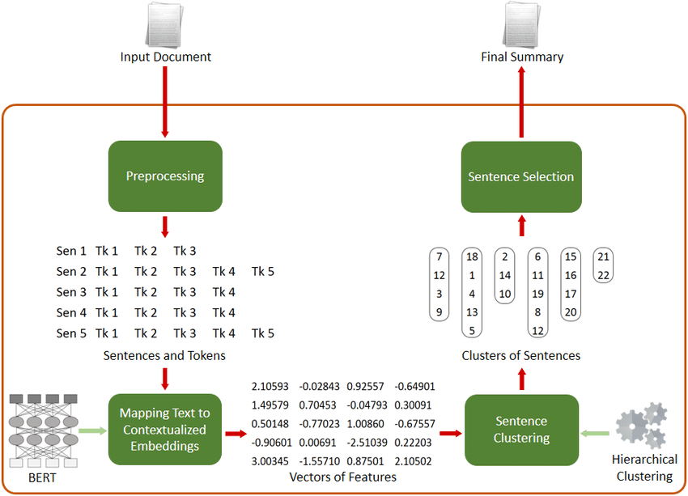
ARCHITECTURES

Slide 11
SYSTEM REQUIREMENTS
High-performance CPU: A multi-core processor (e.g., Intel i7 or AMD Ryzen 7) for efficient computation.
GPU Support: A dedicated GPU (e.g., NVIDIA GTX 1080 or better) for faster training and inference of BERT models.
Memory: At least 16 GB of RAM to handle large datasets and model parameters effectively.
Storage: SSD with a minimum of 512 GB to ensure fast data access and retrieval.
Software Dependencies: Python environment with libraries such as TensorFlow or PyTorch, along with the Transformers library for BERT implementation.

Slide 12
MODULES
Data Preprocessing Module: Handles text cleaning, tokenization, and input formatting for BERT.
Question Generation Module: Utilizes BERT to generate relevant questions from the input text.
Text Summarization Module: Employs BERT for extracting key information and summarizing the content.
Evaluation Module: Assesses the quality and relevance of generated questions and summaries using metrics like BLEU and ROUGE.

Slide 13
APPLICATION
Enhance learning experiences by providing students with autogenerated questions and concise summaries of textbooks, articles, or lectures.
Aid researchers in quickly summarizing academic papers and generating relevant questions to guide their inquiries or literature reviews.
Streamline the content creation process for writers and content marketers by summarizing articles, blogs, or reports and generating insightful questions for reader engagement.
Automatically generate FAQs and summaries from customer inquiries or support documentation to improve user experience in customer service platforms.

Slide 14
ADVANTAGE
Facilitates personalized learning through tailored questions and summaries.
Reduces time spent on information retrieval and summarization for students and researchers.
Generates interactive content that promotes critical thinking and active participation.
Handles large volumes of text efficiently, making it suitable for diverse applications across various industries.

Slide 15
CONCLUSION
Enhances learning, research, and content creation through automated, context-aware questions and summaries.
Suitable for education, research, customer support, and content creation, meeting diverse user needs.
Streamlines information processing, allowing users to focus on deeper analysis and decision-making.
With potential for further improvements, it’s adaptable and ready for larger-scale applications.

Slide 16
REFERENCE
E. Bendig, B. Erb, L. Schulze-Thuesing, and H. Baumeister, ‘‘The next generation: Chatbots in clinical psychology and psychotherapy to foster mental health—A scoping review,’’ Verhaltenstherapie, vol. 32, pp. 64–76, Jan. 2022.
D. Demner-Fushman, W. W. Chapman, and C. J. McDonald, ‘‘What can natural language processing do for clinical decision support?’’ J. Biomed. Informat., vol. 42, no. 5, pp. 760–772, Oct. 2009.
G. Kurdi, J. Leo, B. Parsia, U. Sattler, and S. Al-Emari, ‘‘A systematic review of automatic question generation for educational purposes,’’ Int. J. Artif. Intell. Educ., vol. 30, no. 1, pp. 121–204, Mar. 2020.
R. Doi, T. Charoenporn, and V. Sornlertlamvanich, ‘‘Automatic question generation for chatbot development,’’ in Proc. 7th Int. Conf. Bus. Ind. Res. (ICBIR), May 2022, pp. 301–305.

